Slide 1
Data Mining: Advanced Techniques Graph Mining: part 2
主讲教师: 陈佳伟, sleepyhunt@zju.edu.cn
https://jiawei-chen.github.io/
TA: 陈德仿, defchern@zju.edu.cn
Slides from Sheng Zhou https://zhoushengisnoob.github.io/courses/index.html?course=gnn-2022

Slide 2
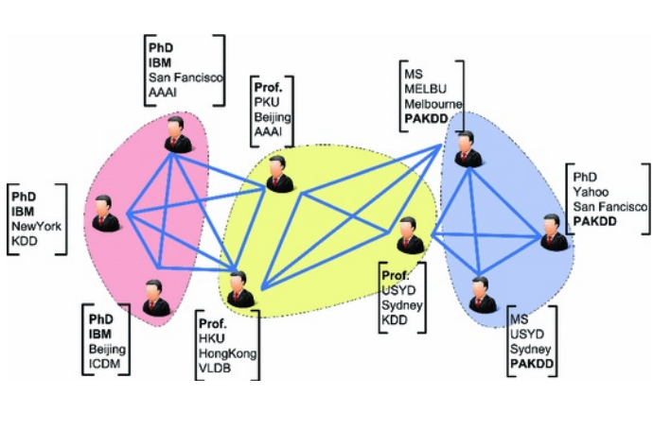
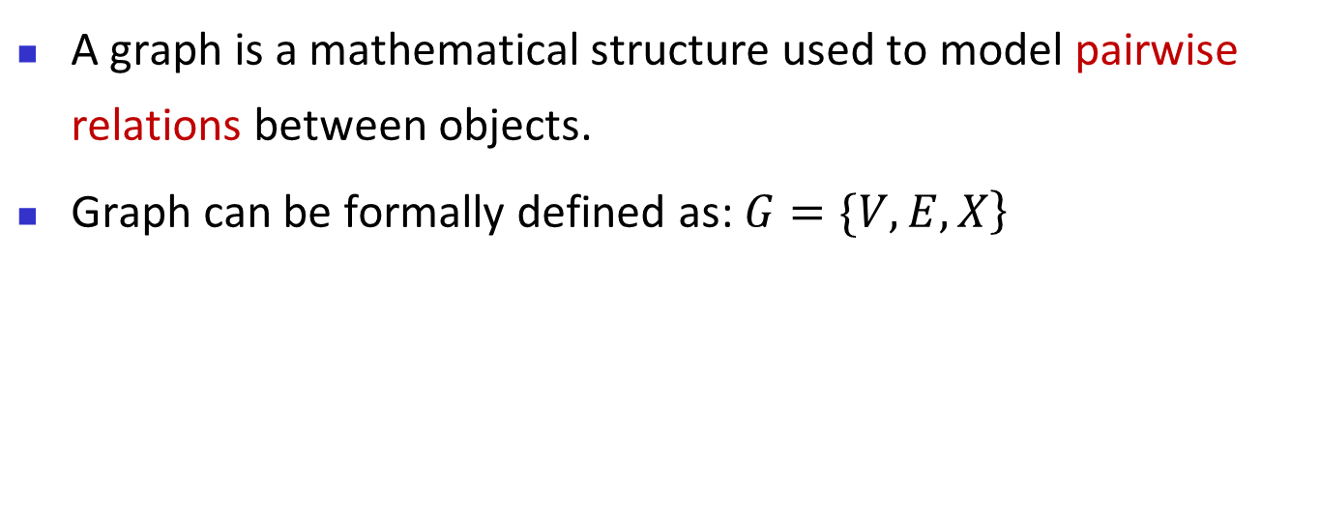
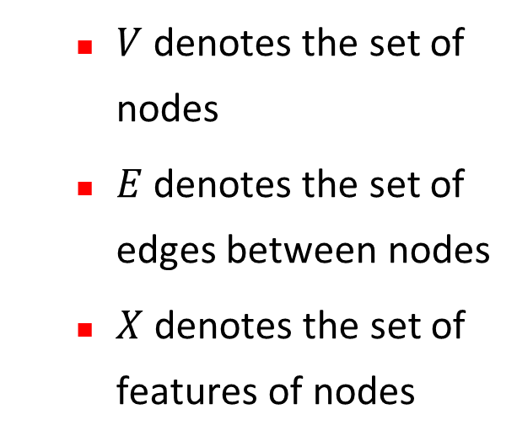
Review --- Graph data
A graph is a mathematical structure used to model pairwise relations between objects.
Graph can be formally defined as: $\left.G=\{V,E,X\right\}$
$V$ denotes the set of nodes
$E$ denotes the set of edges between nodes
$X$ denotes the set of features of nodes
Notes:
机器学习是基础。

Slide 3
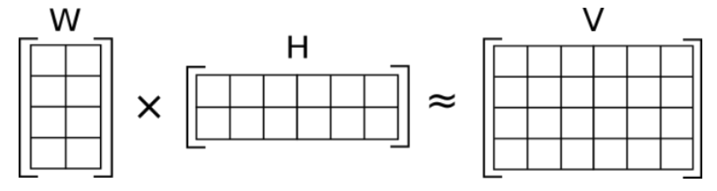
Review---Matrix factorization
Matrix factorization
factorizing a matrix into a product of two lower-dimensional matrices
The goal is to approximate the original matrix by capturing its underlying structure and patterns
W, H: embedding
of nodes
V: graph features
Slide from Sheng Zhou
Notes:
机器学习是基础。

Slide 4
Review---Random walk
Node representation via random walk
Performing random walk on graph to generate multiple sequences of nodes
utilizing word2vec technique to get the node representation
Slide from Sheng Zhou
Notes:
把复杂难搞的图结构信息，转换为序列信息。

Slide 5
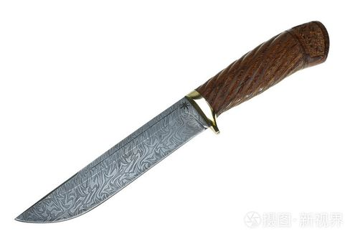
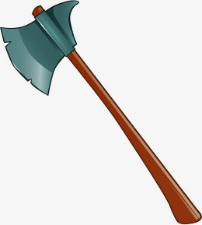


Review---finding new idea
掌握更多的方法：
关注其他领域的方法
对该领域全面调研
深入理解问题：
Notes:
把复杂难搞的图结构信息，转换为序列信息。

Slide 6
Graph Neural Network
Graph data
Classic graph representation learning
Graph neural network
Three perspectives
Applications
Promising directions
6
Notes:
6

Slide 7
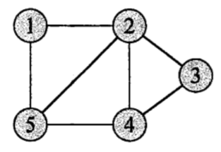
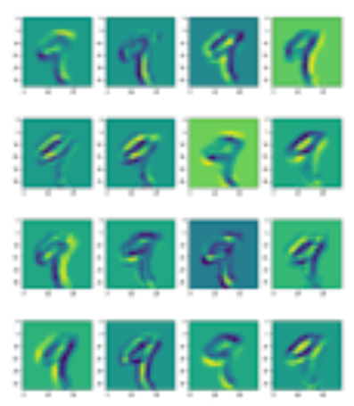
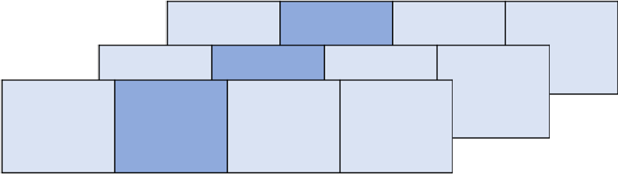
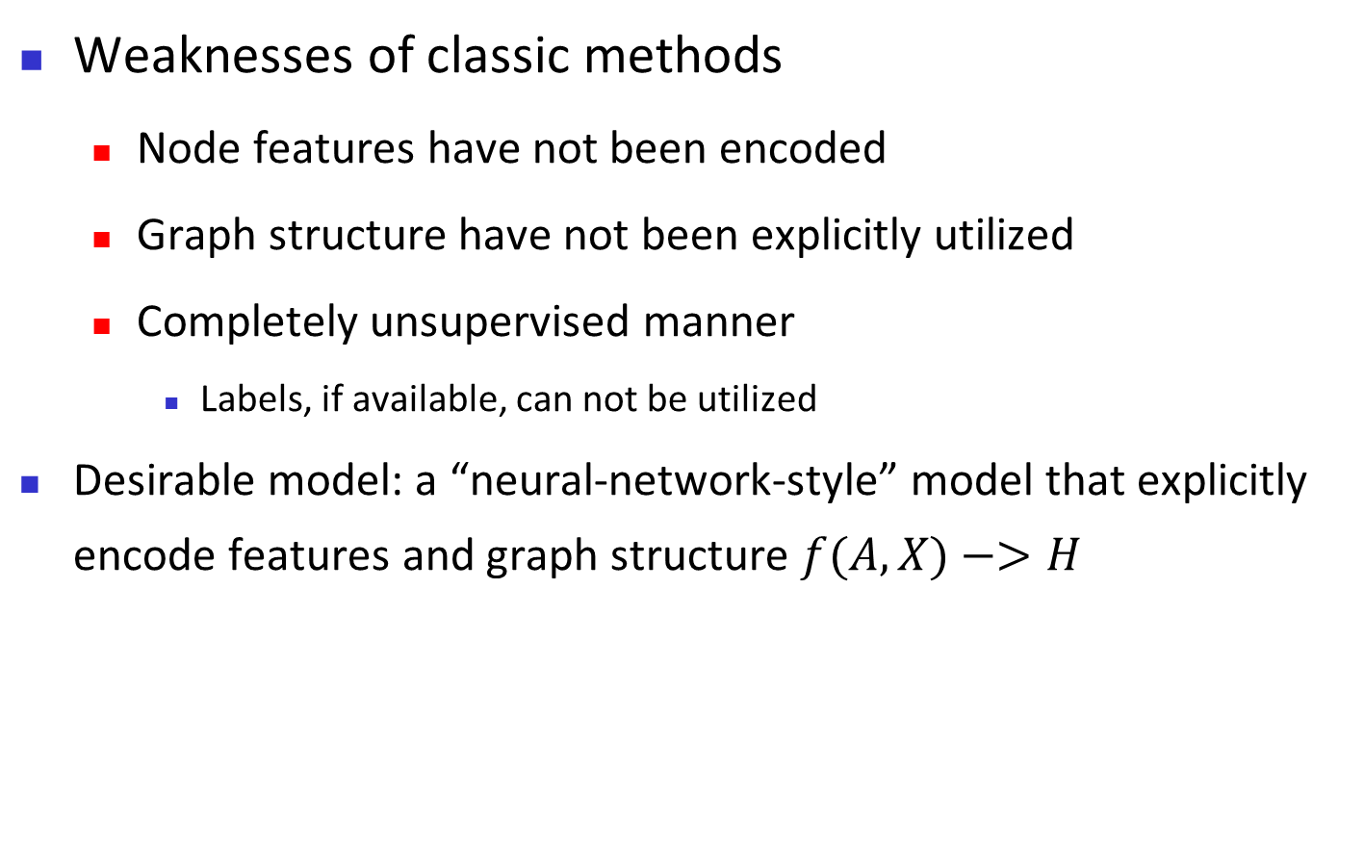
Motivations
Weaknesses of classic methods
Node features have not been encoded
Graph structure have not been explicitly utilized
Completely unsupervised manner
Labels, if available, can not be utilized
Desirable model: a “neural-network-style” model that explicitly encode features and graph structure $f(A,X)−>H$
7
Notes:
7

Slide 8
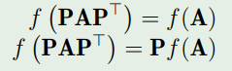
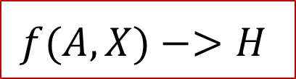
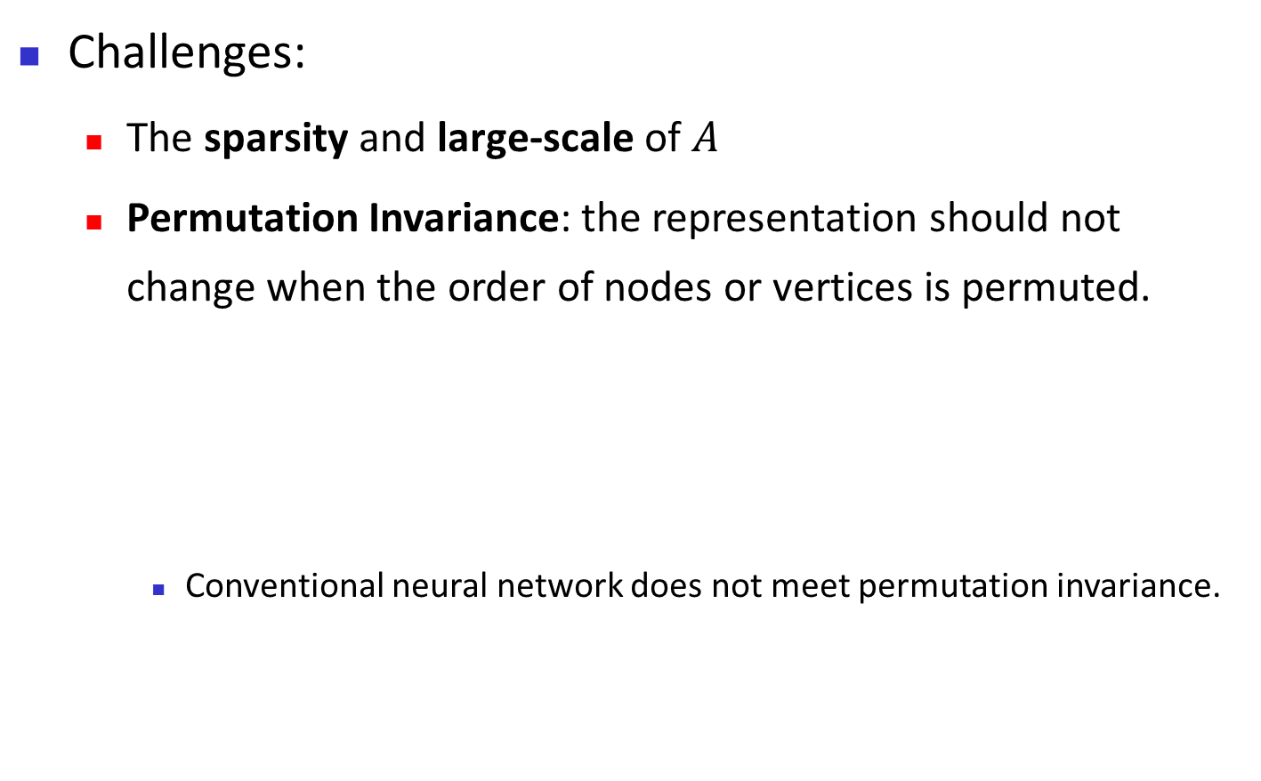
Motivations
$$f(A,X)−>H$$
Challenges:
The sparsity and large-scale of $A$
Permutation Invariance: the representation should not change when the order of nodes or vertices is permuted.
Conventional neural network does not meet permutation invariance.
8
Notes:
8

Slide 9
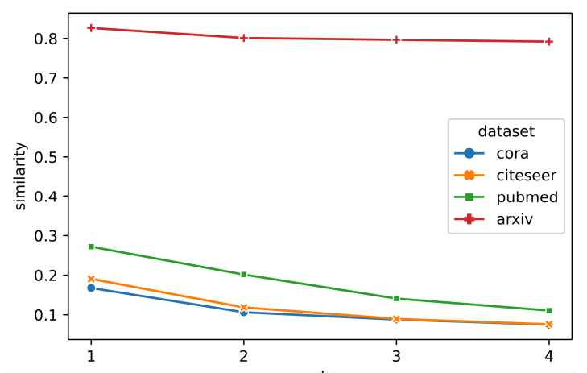
Motivations
Homophily (同质性) assumption:
Nodes with similar attributes or features are more likely to be connected or have edges between them.
Feature similarity with the graph distance
9
Notes:
9

Slide 10
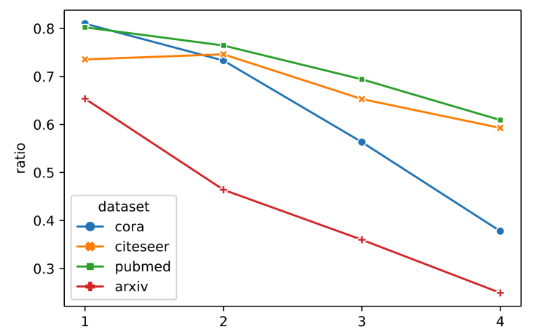
Motivations
Homophily (同质性) assumption:
Nodes with similar attributes or features are more likely to be connected or have edges between them.
Label similarity with the graph distance
10
Notes:
10

Slide 11
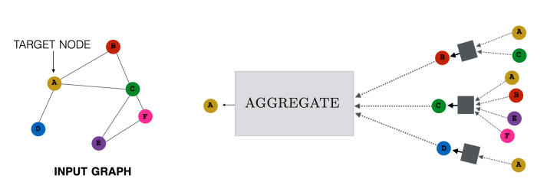
GNN from Spatial Perspective
Neural Message Passing
propagating and aggregating information between nodes in a graph.
Homophily assumption
11
Notes:
11
自己不够，邻居来凑
发扬广大人民群众的力量
举几个例子。 评价一个人如何。看看他community是什么样的。
推荐系统，找导师。

Slide 12
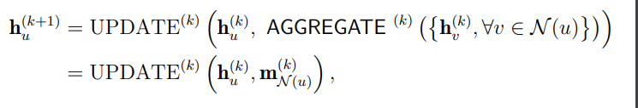
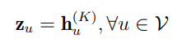
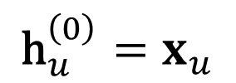
GNN from Spatial Perspective
Formal definition
Two key steps:
Aggregate: how to aggregate information from neighbors
Update: how to update the node features based on the information from the neighbors
$${\text{h}}_{u}^{\left(0\right)}=x_{u}$$
12
Notes:
12

Slide 13
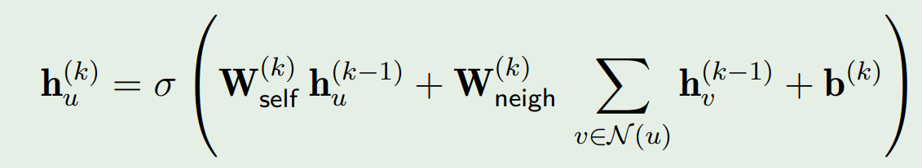
GNN from Spatial Perspective
Basic model
Aggregate: directly average the information of neighbors
Update: update the node feature via a linear layer:
13
Notes:
13

Slide 14
GNN from Spatial Perspective
Generic models
Aggregation
Neighbor Pooling
Neighbor Normalization
Neighbor Attention
Update
Concatenation
Gated Update
14
Notes:
14

Slide 15
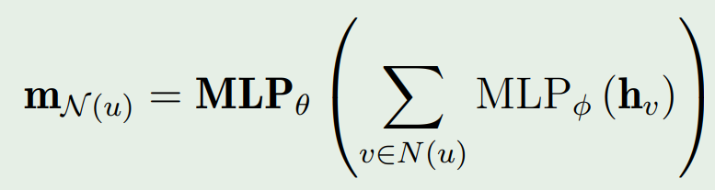
GNN from Spatial Perspective
Neighbor Pooling
Mapping a set of vectors from neighbors to a target vector
Neighbor Pooling maintains permutation invariance by treating neighboring nodes as a set
Mean pooling is the most commonly-used function
This formula can represent any set function invariant to the permutation of neighbors
NIPS’17: Deep sets.
15
Notes:
15

Slide 16
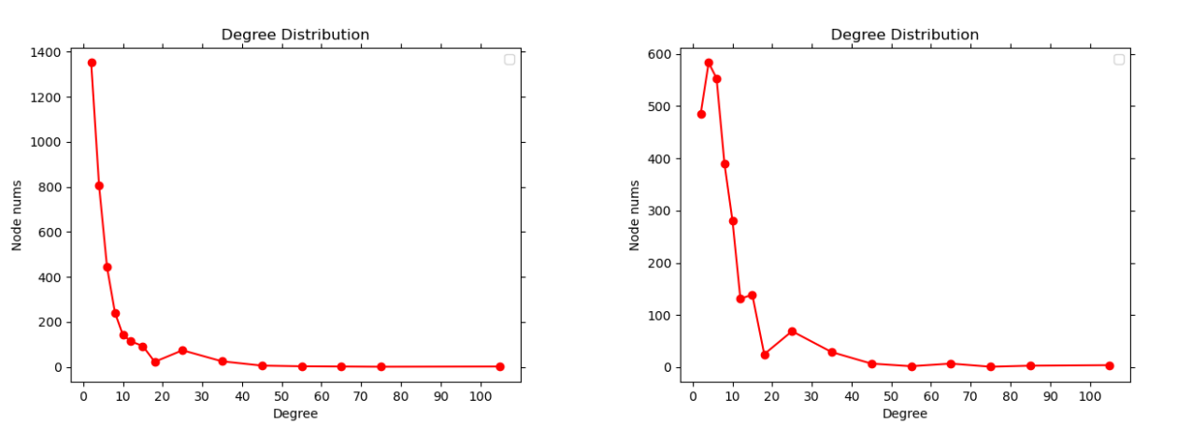
GNN from Spatial Perspective
Neighbor Normalization
Motivations: The long-tailed nature of nodes degrees
high-degree nodes could dominate the aggregation process
explosion of feature magnitude
16
Notes:
16

Slide 17
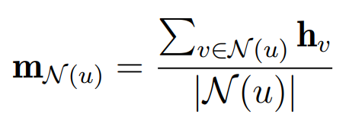
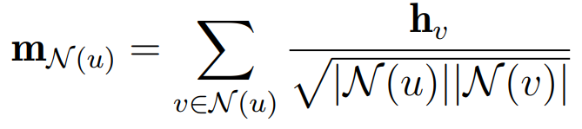
GNN from Spatial Perspective
Neighbor Normalization: two conventional strategies
Discounted by the degree of the target nodes
Considering the degrees of both the target node and the neighbor
sigir'22 : investigating Accuracy-Novelty Performance for Graph-based Collaborative Filtering
17
Notes:
17

Slide 18
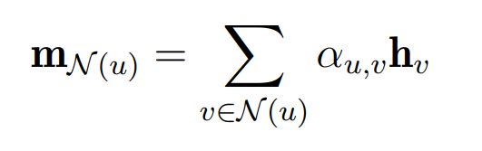
GNN from Spatial Perspective
Neighbor Attention
The qualities of the information from different nodes are diverse
More similar nodes could be more useful
Introducing edge weights to capture the importance of neighbors
18
Notes:
18

Slide 19
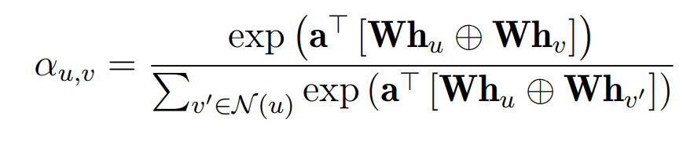
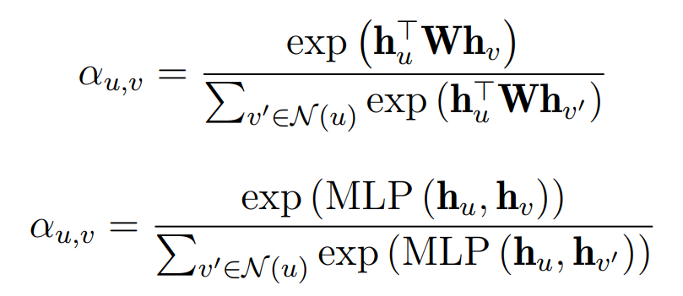
GNN from Spatial Perspective
Graph attention network
Other forms of attention
ICLR’18 : graph attention network
19
Notes:
19

Slide 20
GNN from Spatial Perspective
Summary of neighbor aggregation
Neighbor Pooling
Neighbor Normalization
Neighbor Attention
The key lies on maintain permutation invariant
Which one is better?
According to the specific task and data
“黑猫白猫，能抓老鼠的就是好猫”
Aggregation for complex graph, uncertainty, HIN, dynamic, etc.
20
Notes:
20

Slide 21
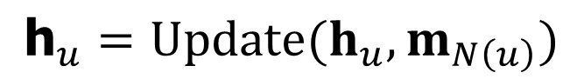
GNN from Spatial Perspective
Update function
Integrate the information from the neighbors to update the node embedding
Basic strategies: concatenation and linear combination
Some complex strategies target at mitigating over-smoothing
Definition of Oversmoothing. The nodes become more similar with the layer of GNN increasing.
Nodes become indistinguishable.
The negligible effect of node features.
$${\text{h}}_{u}=Update(h_{u},m_{N\left(u\right)})$$
21
Notes:
21

Slide 22
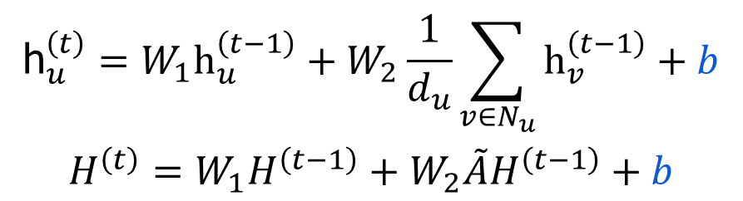
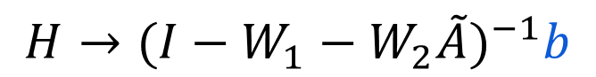
GNN from Spatial Perspective
A toy example of over-smoothing
We have:
regardless of the input features
$$\begin{matrix}{\text{h}}_{u}^{\left(t\right)}=W_{1}{\text{h}}_{u}^{\left(t−1\right)}+W_{2}\frac{1}{d_{u}}\sum_{v∈N_{u}}{{\text{h}}_{v}^{\left(t−1\right)}}+b \\ H^{\left(t\right)}=W_{1}H^{\left(t−1\right)}+W_{2}\tilde{A}H^{\left(t−1\right)}+b\end{matrix}$$
$$H→{(I−W_{1}−W_{2}\tilde{A})}^{−1}b$$
Arxiv’23 : A survey on oversmoothing in graph neural networks
22
Notes:
22
后面我们会讲smoothing effect

Slide 23
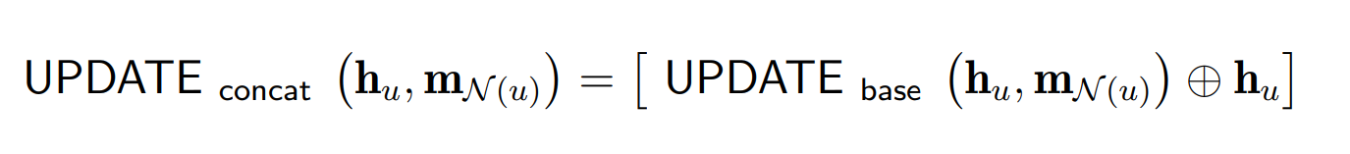
GNN from Spatial Perspective
Concatenate : preserving the inherent information of nodes during the update to mitigate the over-smoothing
Directly concatenate the features of the node itself
23
Notes:
23
后面我们会讲smoothing effect

Slide 24
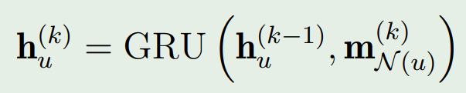
GNN from Spatial Perspective
LSTM, GRU : Memorize the long-term historical information of the node feature
It can also be replaced by other RNN-type module.
24
Notes:
24
后面我们会讲smoothing effect

Slide 25
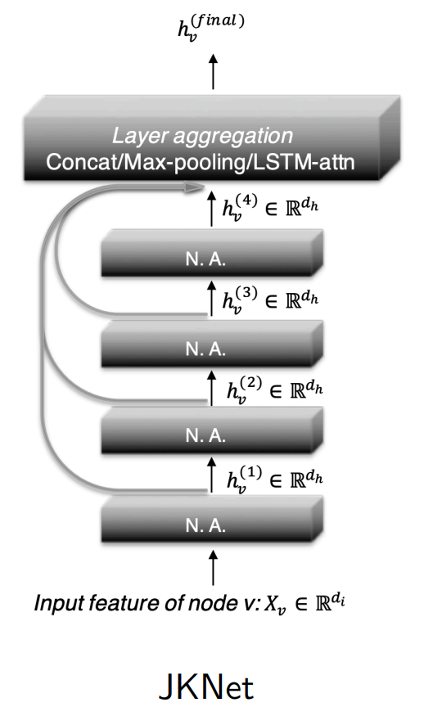
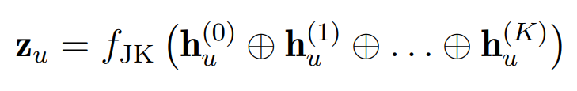
GNN from Spatial Perspective
Jumping Knowledge Connections : utilizing the information from all layers to get the final embeddings
25
Notes:
25
后面我们会讲smoothing effect

Slide 26
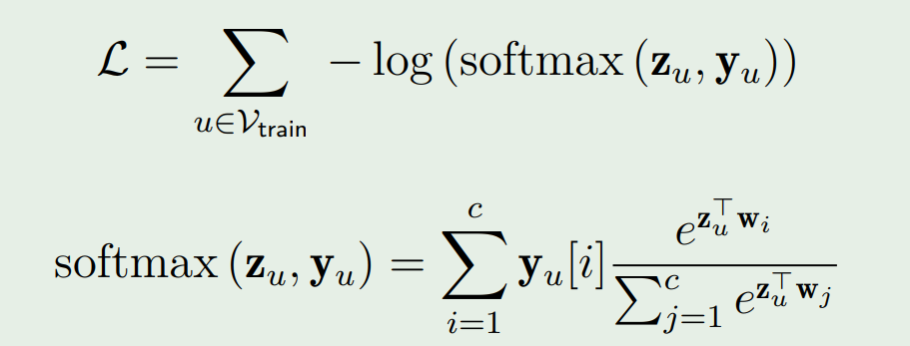
GNN from Spatial Perspective
How to train a GNN model?
Semi-supervised learning:
Unsupervised (self-supervised) learning:
Formulate as a link prediction task
26
Notes:
26
后面我们会讲smoothing effect

Slide 27
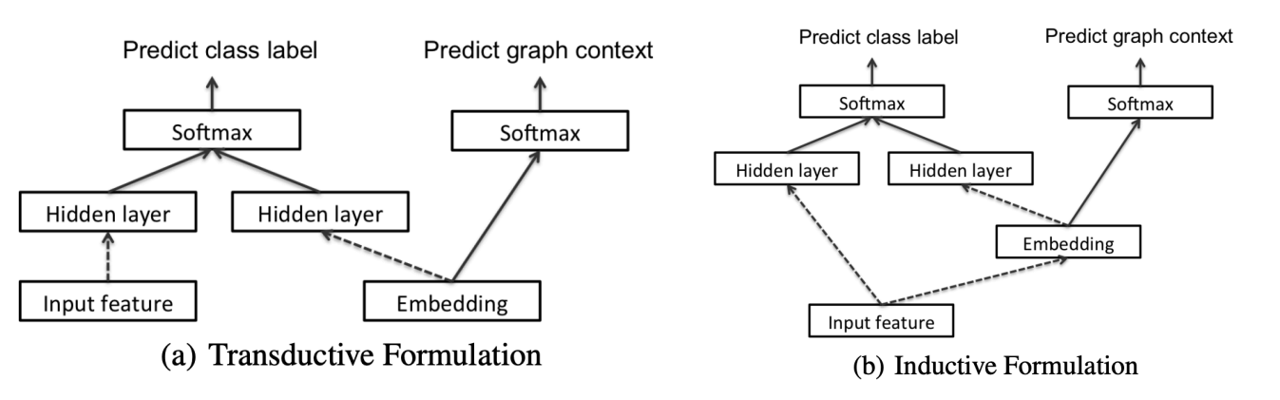
GNN from Spatial Perspective
Transductive VS. Inductive ?
Lies on how to generate embeddings in the test set.
27
Notes:
27
后面我们会讲smoothing effect

Slide 28
Graph Neural Network
…….
Graph neural network
Three perspectives
Spatial Perspective
Spectral Perspective
Loss Perspective
Applications
Promising directions
28
Notes:
28

Slide 29
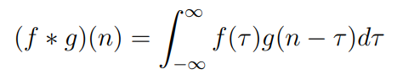
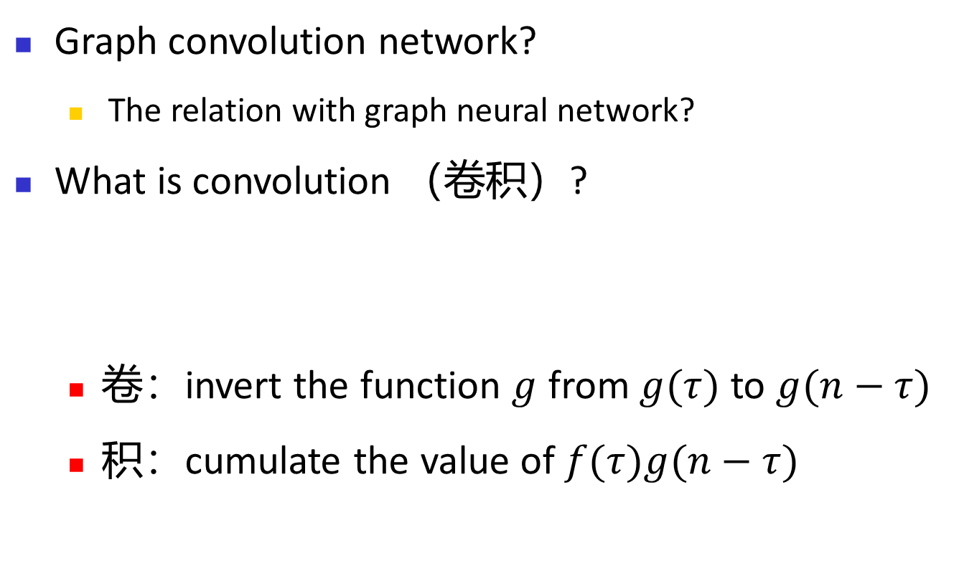
GNN from Spectral Perspective
Graph convolution network?
The relation with graph neural network?
What is convolution （卷积）?
卷：invert the function $g$ from $g(τ)$ to $g(n−τ)$
积：cumulate the value of $f(τ)g(n−τ)$
29
Notes:
29
后面我们会讲smoothing effect

Slide 30
GNN from Spectral Perspective
Convolutional network in computer vision
Motivations
Translation invariance (平移不变性）: the performance of the vision model does not change when the position of object is moved
Locality (局部性）: pixels that are close to each other are more likely to be semantically related or part of the same object than pixels that are far apart
Efficiency & few parameters: the large scale of the pixels
30
Notes:
30
后面我们会讲smoothing effect

Slide 31
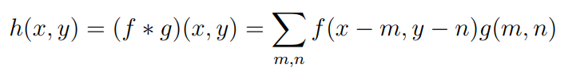
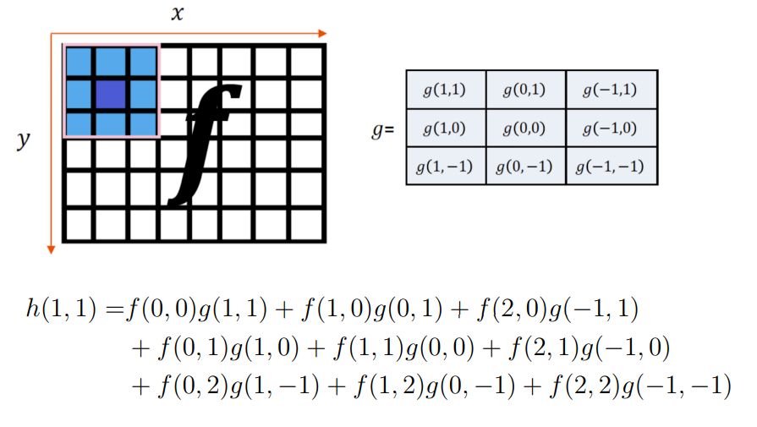
GNN from Spectral Perspective
Convolutional network in computer vision
31
Notes:
31
后面我们会讲smoothing effect

Slide 32
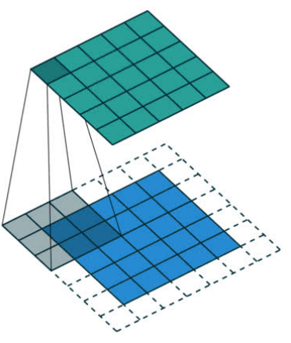
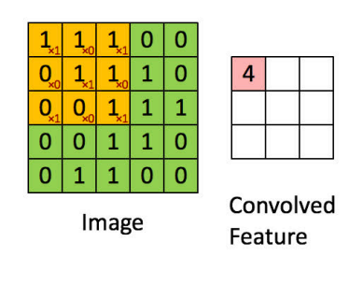
GNN from Spectral Perspective
Convolutional network in computer vision
32
Notes:
32
后面我们会讲smoothing effect

Slide 33
GNN from Spectral Perspective
Transfer convolutional network to graph
Locality
Homophily, Local structure
Translation
invariance
Generalization
Efficiency &
Low Memory
Large-scale & sparse graph
33
Notes:
33
后面我们会讲smoothing effect

Slide 34
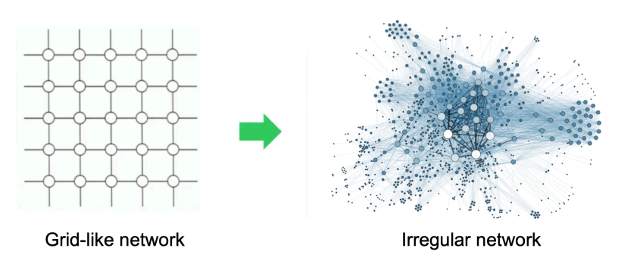
GNN from Spectral Perspective
Challenges:
Permutation invariance
Undefination of f(x,y-1)?
Varying number of neighbors
hard to define convolution kernel
34
Notes:
34
后面我们会讲smoothing effect

Slide 35
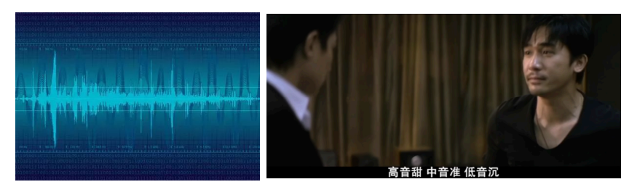
GNN from Spectral Perspective
Fourier Transform: a linear integral transformation that converts time-domain signals into frequency-domain signals
35
Notes:
35
后面我们会讲smoothing effect

Slide 36
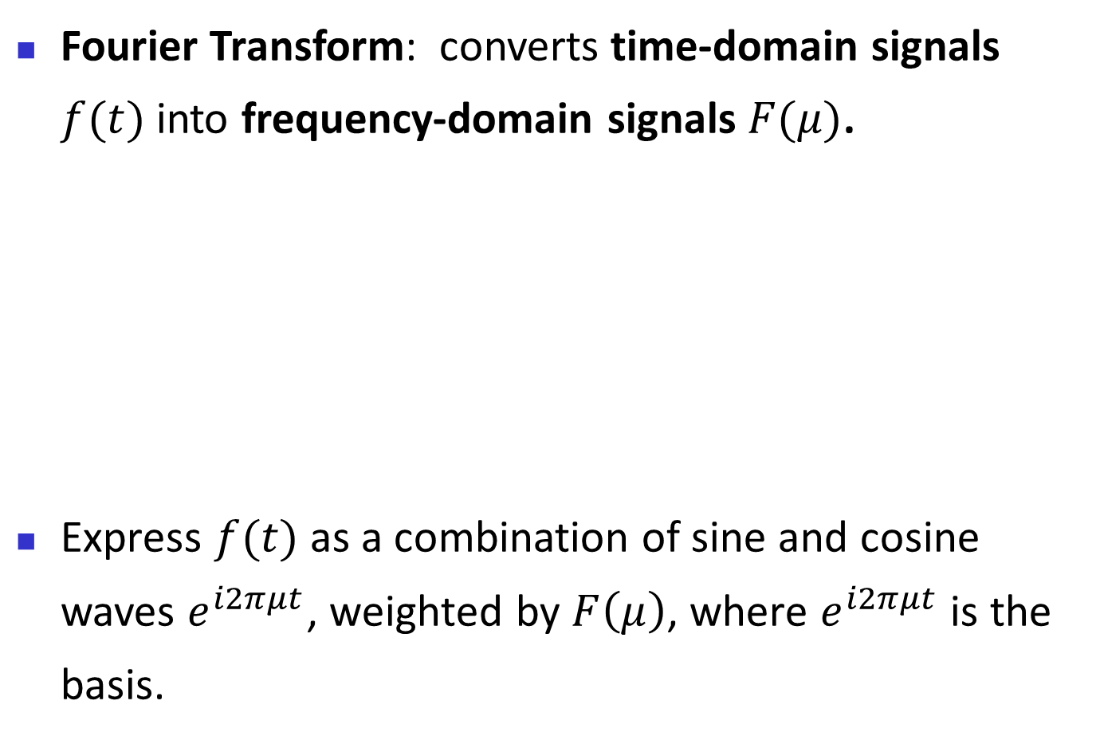
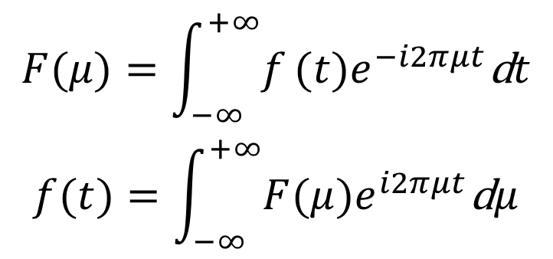
GNN from Spectral Perspective
Fourier Transform: converts time-domain signals $f(t)$ into frequency-domain signals $F(μ)$.
Express $f(t)$ as a combination of sine and cosine waves $e^{i2πμt}$, weighted by $F\left(μ\right)$, where $e^{i2πμt}$ is the basis.
$$\begin{matrix}F(μ)=\int_{−∞}^{+∞}{f}(t)e^{−i2πμt}\text{d}t \\ f(t)=\int_{−∞}^{+∞}{F(μ)e^{i2πμt}\text{d}μ}\end{matrix}$$
36
Notes:
36
后面我们会讲smoothing effect

Slide 37
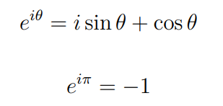
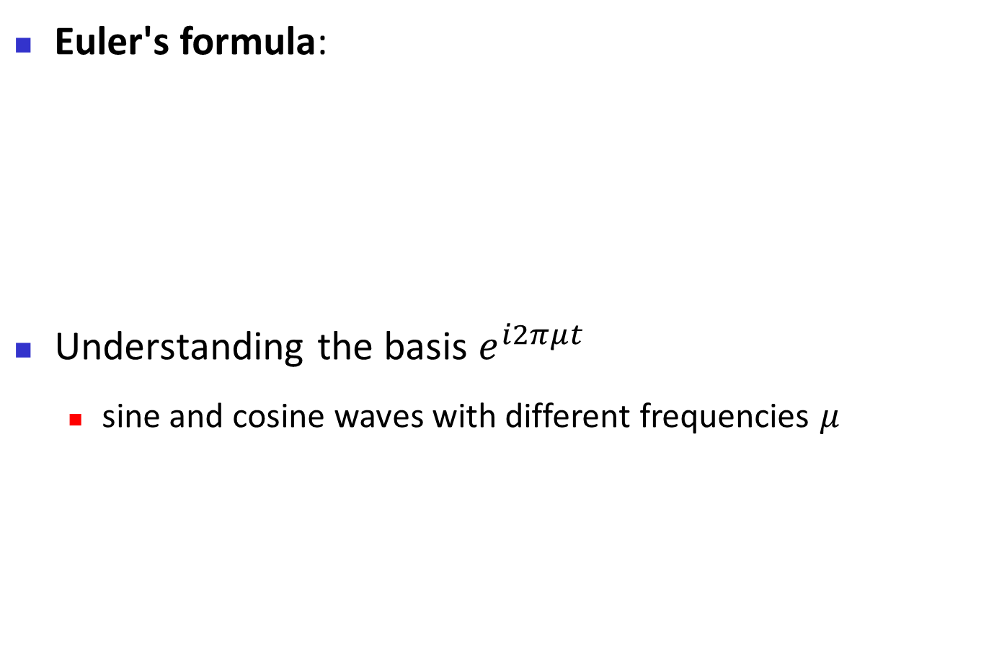
GNN from Spectral Perspective
Euler's formula:
Understanding the basis $e^{i2πμt}$
sine and cosine waves with different frequencies $μ$
37
Notes:
37
后面我们会讲smoothing effect

Slide 38
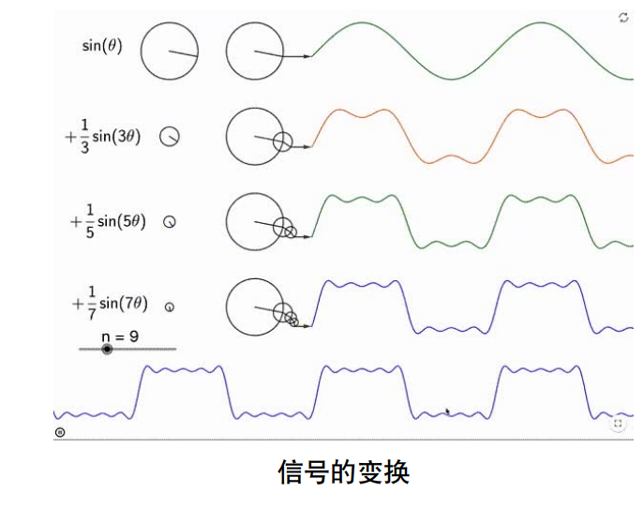
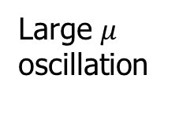

GNN from Spectral Perspective
sine and cosine waves:
Small $μ$
Smoothing
Large $μ$
oscillation
38
Notes:
38
后面我们会讲smoothing effect

Slide 39

GNN from Spectral Perspective
Advantages of Fourier Transform:
Disentangle the original signals according to the frequencies
Different level of smoothing
Operation on the frequency domain, e.g., filtering
Facilitate convolution
The convolution of two functions can be written as the inverse Fourier transform of the product of the Fourier transforms of these two functions.
39
Notes:
39
后面我们会讲smoothing effect

Slide 40
GNN from Spectral Perspective
Spectrum on graph
The key lies on finding a proper space of basis
Indicating different levels of smoothing
Capturing graph structure
Orthogonal
Easy calculation
40
Notes:
40
后面我们会讲smoothing effect

Slide 41

GNN from Spectral Perspective
Laplace operator captures smoothing of a function
the divergence of the gradient of a scalar function
the Laplacian Δf (p) of a function f at a point p measures by how much the average value of f over small balls centered at p deviates from f (p).
$$\left.f(x+s)=f(s)+s^{T}∇f+s^{T}Hs+O({|s|}^{3}\right)$$
41
Notes:
41
后面我们会讲smoothing effect

Slide 42



GNN from Spectral Perspective
Laplace operator on grid data
Differences between neighbors along four directions
42
Notes:
42
后面我们会讲smoothing effect

Slide 43



GNN from Spectral Perspective
Laplace operator on grid data
$$\begin{matrix}\left.Δf(x,y)=div(∇f(x,y)\right) \\ \left.d_{→}=f(x+1,y)−f(x,y\right) \\ \left.d_{←}=f(x−1,y)−f(x,y\right) \\ \left.d_{↑}=f(x,y+1)−f(x,y\right) \\ \begin{aligned}\left.d_{↓}=f(x,y−1)−f(x,y\right) \\ Δf\left(x,y\right)=d_{→}+d_{←}+d_{↑}+d_{↓}\end{aligned}\end{matrix}$$
43
Notes:
43
后面我们会讲smoothing effect

Slide 44



GNN from Spectral Perspective
Laplace operator on graph data
$f$: a function over nodes in graph
Gradient w.r.t edge: ${grad(f)|}_{e }=f\left(u\right)−f(v)$
Define$K$as a $|V|×|E|$incidence matrix
$g={grad\left(f\right)|}_{E }$
$=$ $K^{T}f$
44
Notes:
44
后面我们会讲smoothing effect

Slide 45

GNN from Spectral Perspective
Laplace operator on graph data
Divergence at a point gives the net outward flux of a vector field
Divergence in graph as the collected flows over edges in a graph
45
Notes:
45
后面我们会讲smoothing effect

Slide 46


GNN from Spectral Perspective
Laplace operator on graph data
$Δ(f)=div(grad(f))=KK^{T}f$
$L=KK^{T}$ named as a Laplacian matrix of graph
$L=D−A$?
46
Notes:
46
后面我们会讲smoothing effect

Slide 47





GNN from Spectral Perspective
Laplace operator on graph data
$L=D−A$? YES!
Let $K=[e_{1},e_{2},....e_{m}]$
$$KK^{T}=\sum_{1≤k≤m}{e_{k}e_{k}^{T}}$$
Examining ${T=e}_{k}e_{k}^{T}$, we have:
$$T_{uu}=1,T_{vv}=1,T_{uv}=−1,T_{vu}=−1$$
47
Notes:
47
后面我们会讲smoothing effect

Slide 48



GNN from Spectral Perspective
Property of Laplace matrix
$L=KK^{T}$, Positive semi-definite matrix
Eigenvalues $≥$ 0
Quadratic form of a matrix measures the level of smoothing of a graph
$$f^{T}Lf=||K^{T}f||_{2}^{2}=\sum_{\left(u,v)∈E\right.}{{\left(f_{u}−f_{v}\right)}^{2}}$$
48
Notes:
48
后面我们会讲smoothing effect

Slide 49





GNN from Spectral Perspective
Define basis from Laplace matrix
$\text{Quadratic} \text{form} \text{measures} \text{smoothing} \text{of} \text{a} \text{graph}$
Basis indicate different levels of smoothing like $e^{i2πμt}$
Solve the following problem！
$$f^{T}Lf=||K^{T}f||_{2}^{2}=\sum_{\left(u,v)∈E\right.}{{\left(f_{u}−f_{v}\right)}^{2}}$$
$$u_{1}=\underset{||f||=1}{argmax}f^{T}Lf$$
$$u_{2}=\underset{\left||f|\right|=1,f⊥u_{1}}{argmax}f^{T}Lf$$
$$u_{k}=\underset{\left||f|\right|=1,f⊥span(u_{1},u_{2}..u_{k−1})}{argmax}f^{T}Lf$$
49
Notes:
49
后面我们会讲smoothing effect

Slide 50




GNN from Spectral Perspective
Define basis from Laplace matrix
$[u_{1},u_{2},u_{3},…,u_{n}]$ are the eigenvectors of the matrix $L$
$u_{k}$ indicates different level of smoothing, $λ_{k}=u_{k}^{T}Lu_{k}$
Capturing graph structure: $L=D−A$
Orthogonal
Easy calculation
Fourier transformation on graph
50
Notes:
50
后面我们会讲smoothing effect

Slide 51





GNN from Spectral Perspective
Normalized graph Laplace matrix
Nodes with high degree make too much contribution
$\hat{L}=D^{−1}L$ or $\hat{A}=D^{−1}A$
$\hat{L}=D^{−1/2}LD^{−1/2}$ or $\hat{A}=D^{−1/2}AD^{−1/2}$
$$f^{T}\hat{L}f=\sum_{\left(u,v)∈E\right.}{{\left(f_{u}/d_{u}−f_{v}/d_{v}\right)}^{2}}$$
51
Notes:
51
后面我们会讲smoothing effect

Slide 52



GNN from Spectral Perspective
Convolution on graph
Define kernel on spectral
Final formula
52
Notes:
52
后面我们会讲smoothing effect

Slide 53




GNN from Spectral Perspective
Convolutional network on graph
Directly consider $θ$ as a learnable parameter:
Polynomial parametrization:
Utilize the information of eigenvalues
Localized filters
Arxiv’13: Spectral networks and locally connected networks on graphs.
53
Notes:
53
后面我们会讲smoothing effect

Slide 54







GNN from Spectral Perspective
Convolutional network on graph
Avoiding the calculation over $U$ ($O(n^{2})$)
Utilizing Chebyshev polynomial of order k
Fast calculation O($K|E|$):
NIPS’16: Convolutional Neural Networks on Graphs with Fast Localized Spectral Filtering
54
Notes:
54
后面我们会讲smoothing effect

Slide 55






GNN from Spectral Perspective
GCN: Convolutional +deep neural network
not limited to the explicit parameterization
Enjoying non-linear deep neural network
Let k=2 and $θ_{0}=−θ_{1}$
Suppose we have a feature matrix:
$$H^{\left(t\right)}=σ(\hat{\tilde{A}}H^{\left(t−1\right)}Θ)$$
55
ICLR17’: SEMI-SUPERVISED CLASSIFICATION WITH GRAPH CONVOLUTIONAL NETWORKS (Citation 2W+)
Notes:
55
后面我们会讲smoothing effect

Slide 56


GNN from Spectral Perspective
GCN connects spatial and spectral GNN
$$H^{\left(t\right)}=σ(\hat{\tilde{A}}H^{\left(t−1\right)}Θ)$$
$${\text{h}}_{u}^{\left(t\right)}=σ(Θ^{T}(\frac{1}{|N(u)|}{\text{h}}_{u}^{\left(t−1\right)}+m_{\left.N(u\right)})$$
56
Notes:
56
后面我们会讲smoothing effect

Slide 57
GNN from Spectral Perspective
Summary of GNN from spectral perspective
Convolutional network (Why, How, transfer to graph)
Challenge in graph
Spectral --- Fourier Transform (basis is important)
Basis in graph (what we want? Smoothing!)
Define Laplace matrix in graph (estimate smoothing)
Basis --- eigenvector of Laplace matrix
Different strategies of filtering (efficient!)
GCN --- simplified but deep！
57
Notes:
57
后面我们会讲smoothing effect

Slide 58
Graph Neural Network
…….
Graph neural network
Three perspectives
Spatial Perspective
Spectral Perspective
Loss Perspective
Applications
Promising directions
58
Notes:
58

Slide 59




GNN from Loss Perspective
Considering the following objective function:
Optimizing via gradient descent with learning rate $b$:
Align with original features
Smoothing
$$F^{\left(k\right)}←F^{\left(k−1\right)}−{\left.b⋅\frac{∂ℒ}{∂F}\right|}_{F=F^{\left(k−1\right)}}$$
$$\begin{matrix}{\left.\frac{∂ℒ}{∂F}\right|}_{F=F^{\left(k−1\right)}}=2(F^{\left(k−1\right)}−S)+2c((I−\tilde{A})F^{\left(k−1\right)} \\ F^{\left(k\right)}=(1−2b−2bc)F^{\left(k−1\right)}+2bS+2bc\tilde{A}F^{\left(k−1\right)}\end{matrix}$$
59
Notes:
59

Slide 60



GNN from Loss Perspective
Considering the following objective function:
Let $b=1/(2+2c)$
$c→θ$ & $θ→∞$ ,
$$F^{\left(k\right)}=(1−2b−2bc)F^{\left(k−1\right)}+2bS+2bc\tilde{A}F^{\left(k−1\right)}$$
$$F^{\left(k\right)}≈θ\tilde{A}F^{\left(k−1\right)}$$
60
Notes:
60

Slide 61

GNN from Loss Perspective
Considering the following objective function:
GCN optimizes smoothing regularizer
Explanation of over-smoothing with more layers:
Decrease the difference between neighbors
$$F^{\left(k\right)}≈θ\tilde{A}F^{\left(k−1\right)}$$
61
Notes:
61

Slide 62
Applications
Keeping motivations in mind:
For which data? Relations
For which task? Embeddings
Relations:
Any data involves relations
Any data involves features? Construct graph!
Embeddings:
Learning representation for each objective
62
Notes:
62

Slide 63



Applications
Recommendation system
1 | 1 | 0 | 1
0 | 1 | 0 | 1
0 | 1 | 1 | 1
SIGIR’19: Neural Graph Collaborative Filtering (citation 2100+)
63
Notes:
63

Slide 64


Applications
Language
Create knowledge graph from text
Capturing high-order relations
Knowledge graph embeddings
Knowledge graph embedding: A survey of approaches and applications
64
Notes:
64

Slide 65

Applications
Computer vision
Capturing relations in image
Depicts an image via a graph
Graph embeddings
CVPR’17: Detecting visual relationships with deep relational networks
65
Notes:
65

Slide 66

Applications
Anomaly Detection
Discovering the relations
Construct a graph
Learning embeddings
Forecasting via estimating deviation scores
Drug discover today 21: A compact review of molecular property prediction with graph neural networks
66
Notes:
66

Slide 67
Graph Neural Network
…….
Graph neural network
Three perspectives
Spatial Perspective
Spectral Perspective
Loss Perspective
Applications
Promising directions
67
Notes:
67

Slide 68

Directions
GNN for complex graph
Heterophily graph?
Neighbors can be different！
68
Notes:
68

Slide 69

Directions
GNN for complex graph
signed graph
Edge=-1 suggests quite dissimilar notes
69
Notes:
69

Slide 70

Directions
GNN for complex graph
Heterogeneous graph
Resigning GNNs for handling different types of nodes and edges
70
Notes:
70

Slide 71

Directions
GNN for complex graph
Temporal graph
Modeling both temporal patterns and graphic patterns
71
Notes:
71

Slide 72

Directions
Robust GNN
The graph structure is not accurate!
Graph structure learning for refining graph.
NIPS23: OpenGSL: A Comprehensive Benchmark for Graph Structure Learning
72
Notes:
72
Heurstically, the strategy for recovering features

Slide 73

Directions
Robust GNN
Distribution shift
DRO, invariant learning, causal inference
Indentifying important motifs (explanation)
73
Notes:
73
Heurstically, the strategy for recovering features

Slide 74

Directions
Robust GNN
Attacks
Developing different types of attacks and defending accordingly
74
Notes:
74
Heurstically, the strategy for recovering features

Slide 75


Directions
GNN theories
Expressive ability
Connecting GNN with WL test
ICLR’19: How powerful are graph neural networks? (Citation 5800+)
75
Notes:
75
Heurstically, the strategy for recovering features

Slide 76


Directions
GNN theories
Over-smoothing
Over-squashing
bottleneck
76
Notes:
76
Heurstically, the strategy for recovering features

Slide 77


Directions
Transformer in graph
Position encoding
Efficiency
Combined with GNN
77
Notes:
77
Heurstically, the strategy for recovering features

Slide 78

Thank you!
Notes:
Thank you! Due to the time is limited. I can not give the answers of your questions now.
But please feel free to contact us with e-mail, we will give your feedback as soon as possible.

